Slide 1
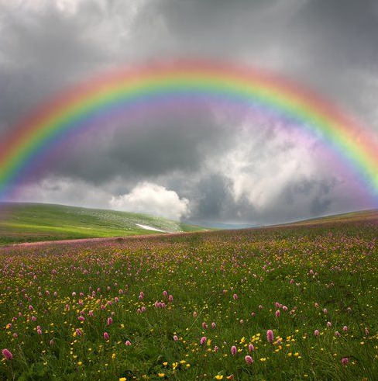
Colour and Rainbows
Learning intentions:
To make a rainbow
To understand how rainbows are created.

Slide 2
Light and Colour
Who can make a rainbow?!
Use the light boxes and various objects to try and make a rainbow…

Slide 3
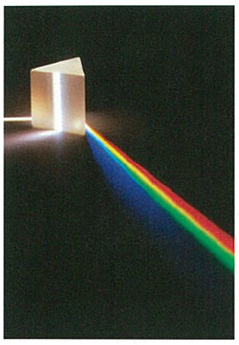
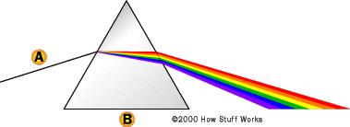
Light and Colour
Using the prism (triangular shaped object),create a rainbow.
Cut some A4 in half.
Draw the formation of the rainbow on your paper.
When finished, borrow another prism.
Can you combine the colours to create white light again?!

Slide 4
Why does this happen?
Order the steps below to explain how rainbows are formed.
A. This causes the white light to split into its different colours.
B. When white light is refracted by a prism,
C. the colours slow different amounts (because of their different wavelengths).
D. These colours have different wavelengths.
E. White light is made up of many colours.

Slide 5
Why does this happen?
E. White light is made up of many colours.
D. These colours have different wavelengths.
B. When white light is refracted by a prism,
C. the colours slow different amounts (because of their different wavelengths).
A. This causes the white light to split into its different colours.

Slide 6
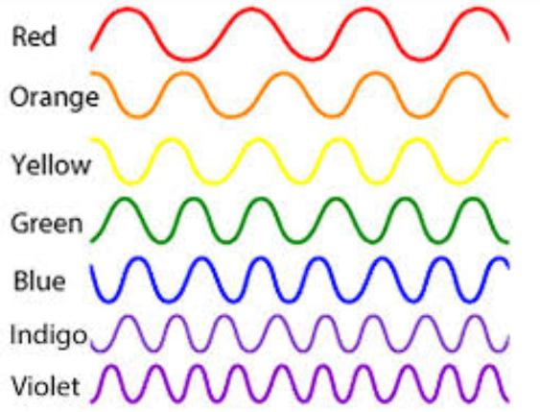

Slide 7
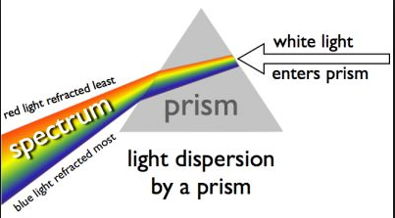

Slide 8
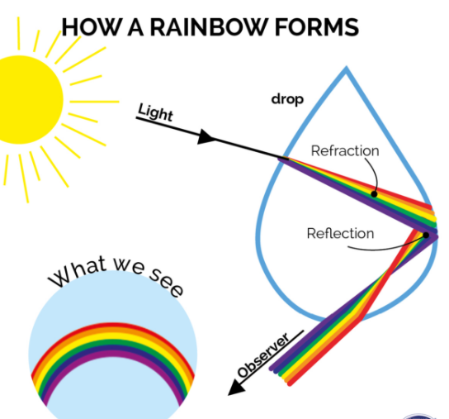

Slide 9
Now try and explain again…
Without looking at any books, try and remember what you just discovered.
Explain it to a partner. Take it in turns.

Slide 10
TRUE FALSE STAND UP SIT DOWN
For the following slides, decide true or false.
When I say “1, 2, 3 GO!!” you:
Put your hand up if it is true
Keep your hand down if it is false.
Any hesitation or mind changing = OUT!!
Sit down if you are wrong.

Slide 11
TRUE
White light is made up of many colours.

Slide 12
FALSE
A rainbow is caused because of reflection only.

Slide 13
FALSE
A rainbow is caused because of refraction in a prison.

Slide 14
FALSE
A rainbow is caused because light speeds up in a prism.

Slide 15


Slide 16
Light and Colour Quiz
Answer the following questions on your WBs.
2 minutes for each.

Slide 17
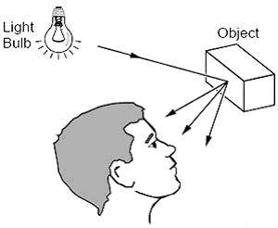
1. Why can we see objects?
Because light reflects off an object and we see that light.

Slide 18
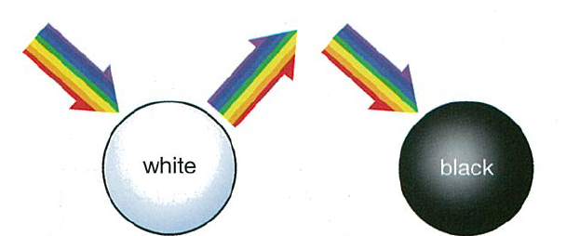
2. What is the difference between white and black objects?
White objects reflect all light, black objects absorb most light (we see the absence of light = a gap in the light).

Slide 19
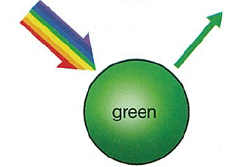
3. In reality, what colour light will a green object reflect?
Mostly green light, but also a little light either side of it.
So some yellow and blue light too.

Slide 20
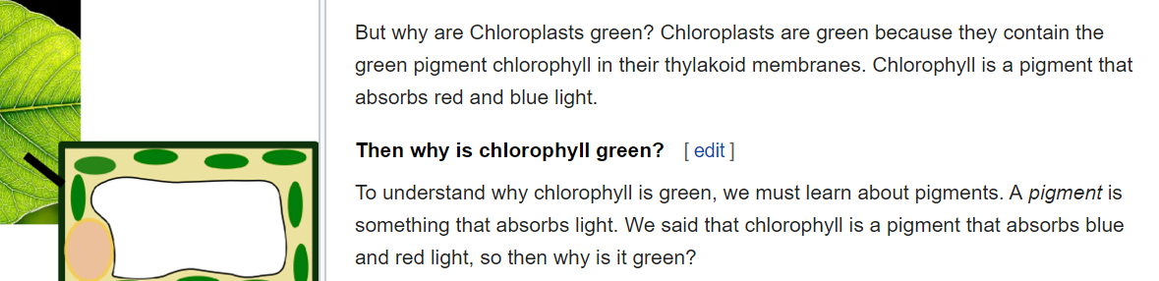
Extension: Why are plants green? (and not black?)
Plants evolved from green algae?
To avoid overheating?
While green light does penetrate deeper into leaves to the spongy mesophyll, in higher flux densities it can cause photodestruction.
Sunlight consists of primarily blue and red light mixed together, which are exactly the colors that chlorophyll molecules like to absorb. Light is a form of energy, so the chlorophyll is able to harvest the sunlight with little waste.

